Slide 1
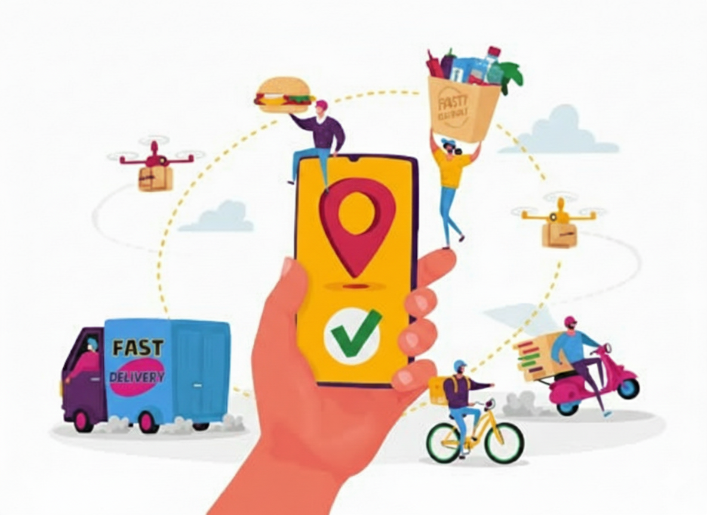
EXPLORING CUSTOMER BEHAVIOR THROUGH DATABASE ANALYSIS
A Real-Life Data Analyst Case Study

Slide 2

Introduction
In today’s competitive online food delivery industry, understanding customer behavior is key to improving sales, customer loyalty, and overall business growth.
This project is a case study based on an online food ordering platform. The dataset includes 5 tables:
Sales (orders placed by customers)
Product (menu items with prices)
Users (customer signup details)
User_Name (user IDs with names)
Goldusers_Signup (customers who upgraded to gold membership)

Slide 3
Introduction
The main objective is to analyze customer purchase patterns, product popularity, and gold membership performance using SQL queries.
By uncovering these insights, the company can make data-driven decisions in :
Expanding its loyalty program.
Optimizing product offerings.
Improving customer experience through personalization.

Slide 4

Methodology
Data and Tools
Data Source: Customer transactions dataset (5 relational tables)
Database Design: Defined primary and foreihn keys.
Tools: Sql Server was used for querying.

Slide 5

Methodology
Process Flow
Step1: Created the 5 tables and inserted data into it.
Step2: Ran queries to get insights about the businesss.
Step3: Used JOIN, GROUP BY, SUM, COUNT, RANK, DATEDIFF for deeper insights
Step4: Compared Gold vs Non-Gold users in terms of revenue & behavior.
Step5: Derived trends → yearly sales, product popularity, customer preferences.

Slide 6

Key Findings
Sales & Product
Top Revenue Product: Butter Chicken with Rs.1700 total revenue
Top 3 Products by Revenue:
Butter Chicken – ₹1700
Shahi Paneer – ₹1360
Mutton Biryani – ₹1350
Lowest Revenue Product: Mango Lassi with ₹80 revenue
Most Purchased Item: Shahi Paneer with highest order count

Slide 7

Key Findings
Gold vs Non-Gold users
There are total of 10 users out of which 5 are gold users.
Revenue Contribution:
Gold Users– ₹3830(55%)
Non-gold Users – ₹3060(45%)
Popular Product Among Gold Users: Dal Makhani
Gold membership Tenure:
Anshul & Sahil – 8 years
Sreya & Aryan– 7 years
Priya– 6 years

Slide 8
Key Findings
Customer Trends
Yearly Revenue Trends:
Highest Revenue in 2017 and Lowest Revenue in 2014 .
Growth peaked 2016 → 2017, slight decline afterward.
First Orders:
Dal Makhani was the first order for 4 users.
Chicken Tikka was the first order of 2 users.
Behaviour Insights:
Gold members place more frequent orders
Spending before & after gold signup varies, showing increased loyalty post-membership
Clear favorites suggest scope for personalized

Slide 9

Insights
Customer Behaviour
Customers show strong loyalty to specific dishes like Butter Chicken, Shahi Paneer and Dal Makhani
Gold members consistently spend more and order more frequently proving the effectiveness of the loyalty program.
Non-gold users contribute less revenue, highlighting the importance of converting them.
First orders (like Dal Makhani, Chicken Tikka) often become gateway dishes that drive repeat behavior.

Slide 10
Insights
Sales & Trends
Sales revenue peaked in 2017 but declined afterward → indicates potential customer churn or lack of new engagement strategies.
Certain products (Mango Lassi, Veg Curry) remain underutilized, suggesting mismatched customer preferences.
Gold membership signup dates spread over years (2017–2019) → shows steady adoption but also room to accelerate growth.
Seasonal or yearly variations show that marketing campaigns should align with peak demand periods.

Slide 11
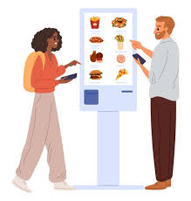
Actionable Insights
Product & Revenue
Promote Top Products: Butter Chicken, Shahi Paneer, and Mutton Biryani are revenue leaders → highlight them in ads & special combos.
Boost low selling item: Mango Lassi & Veg Curry have very low sales → either improve visibility or phase them out.
Personalized Recommendations: Each customer has a clear favorite dish → recommend these items in repeat orders to increase loyalty.

Slide 12
Actionable Insights
Gold Membership and Customers
Expand gold membership: Gold users spend 55% of total revenue despite being only 50% of users → push upgrade offers to non-gold customers
Retention Strategy: Revenue peaked in 2017, then declined → re-engage inactive customers with discounts, festive offers, or loyalty points.
Personalized Recommendations: Each customer has a clear favorite dish → recommend these items in repeat orders to increase loyalty.
Leverage first order Insights: Dal Makhani is the most common first dish ordered → offer it as a “Welcome Dish Discount” to attract new users.

Slide 13
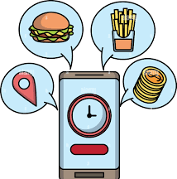
Conclusion
This project analyzed customer behavior using SQL queries on sales, users, products, and gold membership data.
Analysis of customer sales data revealed clear purchase patterns.
Gold Members spend more & order more → program adds strong value.
Revenue peaked in 2017, slight decline afterward.
Customers show loyalty to favorites & repeat behaviors.
Findings highlight the need for targeted promotions, stronger engagement, and gold membership expansion.

Slide 14

Thank you!

